Slide 1


NEW MEMBER ORIENTATION
rascw.org 608-240-2800

Slide 2

INTRODUCTIONS
Your Name
Your Brokerage
Why have you chosen real estate?
What are you most excited about & least excited about?
Hobbies/Family/Charity?

Slide 3

BEFORE WE GET STARTED
Today is interactive. Please engage with the speakers and each other, and ask lots of questions!
Please silence your phones
You will receive a link to this presentation following the session.

Slide 4


WHAT WE'LL COVER
Use of “REALTOR®”
You & Your Associations
Advocacy
Professionalism: Antitrust, Personal Safety, and Cybersecurity
Professional Standards: Ethics & Arbitration
Fair Housing
RASCW President & Your Swearing In
Optional Paragon Basics Training @3:00

Slide 5




PROPER USE OF “REALTOR®”

Slide 6



PROPER USE
OF “REALTOR®”
The REALTOR® Trademarks include:
REALTOR®
REALTORS®
REALTOR-ASSOCIATE®
The REALTOR® block “R” logo

Slide 7
The following are all proper uses of REALTOR® by a member named Jane Smith:
Proper Uses:
Janesmithrealtor
Jsmithrealtor
Smithrealtor
jane_smith_realtor
realtorjanesmith
realtorjsmith
jane_the_realtor
jane_a_realtor
The following are all improper uses of REALTOR® because they include a descriptive word or phrase in connection with the MARK:
Improper Uses:
Chicagorealtor
Yourchicagorealtor
your_chicago_realtor
cyberrealtor
virtualrealtor
realtor_mom
realtorsolution
localrealtor
PROPER USE
OF “REALTOR®”

Slide 8

KNOW THE RULES
Needing to correct your website, domains, business cards, logo, etc. can get expensive!
For additional resources, check out the Trademark Use Resource Guide located here:
https://www.nar.realtor/membership-marks-manual

Slide 9
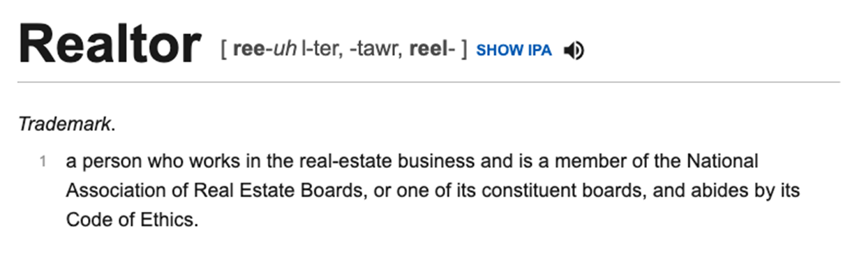
PRONUNCIATION
You Would Never Say “Doc-uh-tor” for Doctor, So Don't Say “Reel-uh-tor”!

Slide 10
YOU & YOUR ASSOCIATIONS
NAR: National Association of REALTORS®
WRA: Wisconsin REALTORS® Association
RASCW: REALTORS® Association of South Central WI

Slide 11


The Voice for Real Estate
NAR Consists of Members of ALL of the
STATE and LOCAL Associations NATIONWIDE.

Slide 12


BENEFITS & SERVICES
Consumer Advertising Campaign
Center for Financial Wellness
Commitment to Excellence (C2EX)
Library
REALTOR® Magazine
Market Statistics
National Convention
National REALTOR® Database
RPR

Slide 13
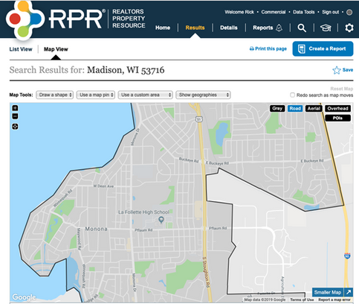
REALTORS® PROPERTY RESOURCE
www.NARRPR.com
100% OWNED BY REALTORS®:
Created by NAR for the sole purpose of providing data needed
to meet the demands of clients.
EXCLUSIVELY FOR REALTORS®:
No third party or public access. The only way a non-REALTOR® has access to the data is through a report CREATED by a REALTOR®
NO COST MEMBER BENEFIT:
RPR is a benefit offered exclusively to REALTORS® at NO COST. Services Residential, Commercial, Brokers, Appraisers and MLS's.

Slide 14

NAR.REALTOR/thats-who-we-r
Resources & Assets that you can use to promote your business.
THAT’S WHO WE R CAMPAIGN

Slide 15



Advanced Education & Designations
Accredited Buyer Representative
Certified Residential Specialist
Graduate, REALTOR® Institute

Slide 16

FINDING NAR RESOURCES
www.NAR.REALTOR
Online shopping for real estate products, including marketing strategies, statistics and much more, PLUS National REALTOR® Database and updates on real estate related issues.

Slide 17

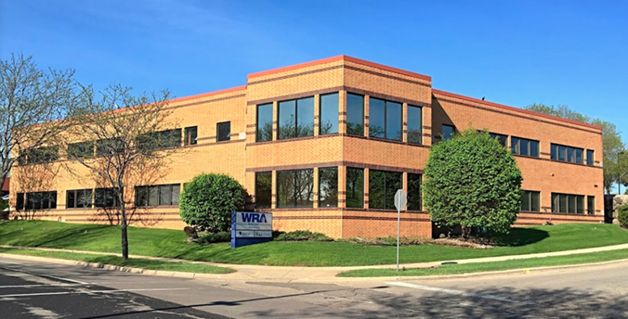
The WRA is a STATE ASSOCIATION
made up of Members of the NINETEEN Wisconsin Local Associations.

Slide 18

BENEFITS & SERVICES
Continuing Education and Licensing Courses
Success tips on building your business
Access to ZipForms
Legal updates on issues affecting the industry
Legal Hotline
Intervention with Department of Safety and Professional Services
Government Affairs and Lobbying at State Level
Wisconsin market statistics
Monthly Magazine
State Conventions

Slide 19
FINDING WRA RESOURCES
www.WRA.org
Online shopping for real estate products, including marketing strategies, statistics, and much more, PLUS Wisconsin REALTOR Database, Legal Hotline, and Updates on LOCAL real estate related issues.

Slide 20


Your LOCAL association.
RASCW is a TEAM made up of members (YOU), and the RASCW and South Central WI MLS staff!
Let’s get acquainted…

Slide 21
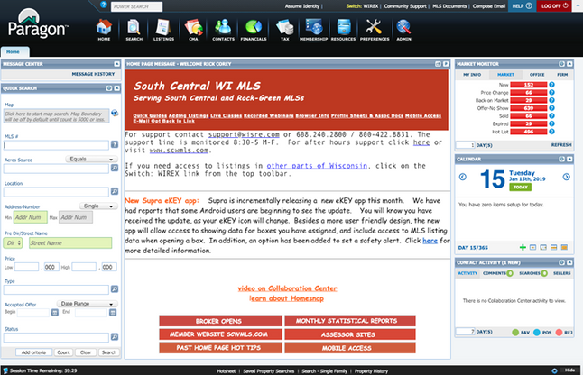
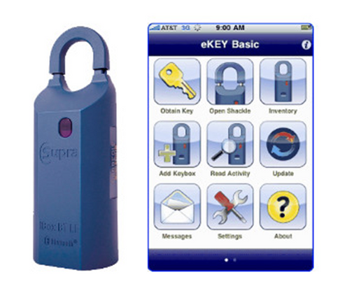
SOUTH CENTRAL WI MLS
www.scwmls.com
Listing Rules - Statistics - Support - Public Records - Forms
Statistics are pulled on the 12th of every month and published across social media platforms, as well as in the monthly newsletter.
Paragon MLS System: scwmls.paragonrels.com
Supra Keyboxes/eKEY

Slide 22
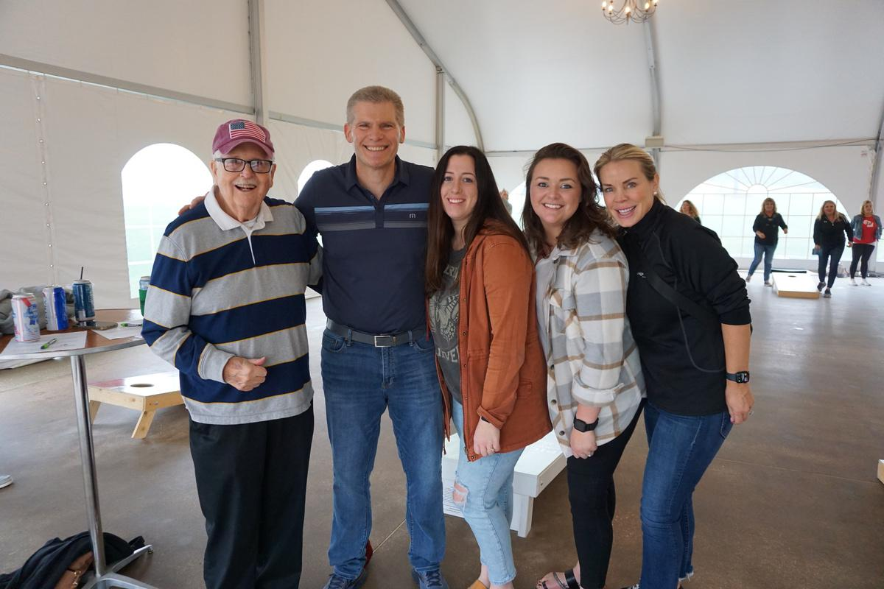
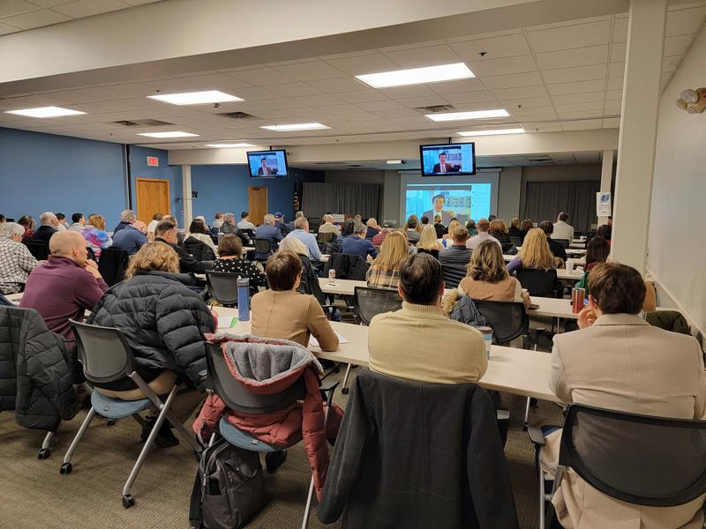
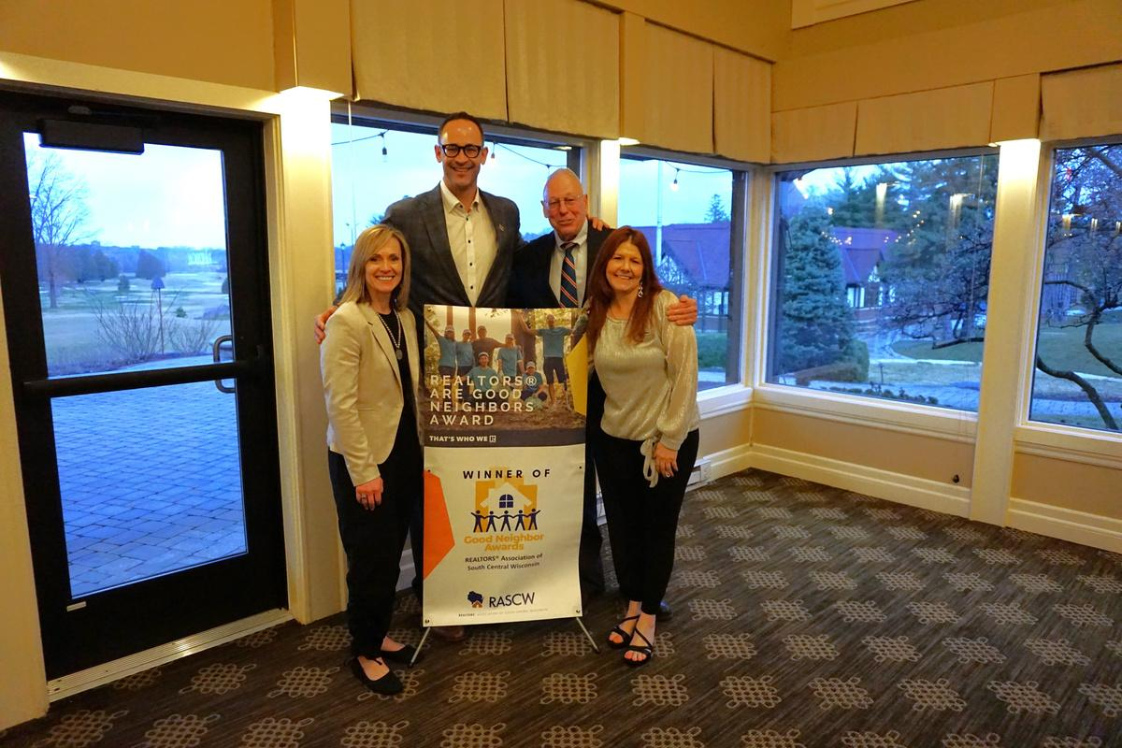
CONNECT
Build Connections: Networking, outreach, committees
Access Support: Staff, sponsorships, advertising
Advocate: Industry and legislative action
RASCW MEMBER
BENEFITS & SERVICES
LEARN
Empower Your Growth: Professional development and leadership.
Stay Informed: Local market insights and industry updates
Equip Your Success: Tools, resources, and ethics support
THRIVE
Grow & Advance: Build your business and career
Strengthen Communities: Support local growth & promote homeownership
Sustain Industry Health: Back a strong real estate market
https://www.rascw.org/member-services/rediscover-the-value-of-rascw/

Slide 23
TASK FORCES/COMMITTEES:
TASKFORCES, COMMITTEES,& CHAPTERS
Commercial Services
Professional Standards
Orientation
Member/YPN Networking
Learning Lab
Community Engagement/Housing Awareness
Investment Taskforce
RASCW Housing Foundation
Government Affairs
MLS Committee
CHAPTERS:
Green Lake Chapter
Sauk Columbia Chapter
Southwest Chapter

Slide 24
RASCW
EVENTS
Many events support causes in the community!
Memorial Golf Outing
Bocce Ball & Backpacks Tournament
Trivia Extravaganza
Bags Tournament
Euchre Tournament
Holiday Party & Gift Drive
Governmental Affairs Silent and Live Auction
https://members.rascw.org/events

Slide 25
COMMERCIAL REAL ESTATE
RASCW Commercial Committee
Commercial Events - this year:
Introduction to Commercial Real Estate - national speaker
Commercial Tools: REALTORS® Property Resource (RPR) webinar
Annual Commercial Real Estate Summit
Commercial Tools & Resources:
Advocacy: nar.realtor/commercial/advocacy
Research & Statistics: nar.realtor/research-and-statistics/research-reports/commercial-research
Education: nar.realtor/commercial/courses-designations-and-events

Slide 26

Contact
rascw@wisre.com
HOW TO GET INVOLVED WITH RASCW:
www.rascw.org 608-240-2800
Look for emails from us and our monthly newsletter!
Facebook
Instagram
LinkedIn
Twitter
YouTube
HOW TO FIND
RASCW
RESOURCES:

Slide 27


ADVOCACY
The REALTOR® Party is a powerful alliance of REALTORS® and REALTOR® Associations working to protect and promote homeownership and property investment.

Slide 28
ADVOCACY & CAMPAIGNS
The REALTOR® Party speaks with one voice to advance candidates and public policies on federal, state, and local levels that build strong communities and promote a vibrant business environment.
Locally, we support people and policies that promote homeownership, strong neighborhoods, and great schools.
The REALTOR® Party is forging a new path with a bipartisan, issue-oriented approach to politics. We support those who listen to and support us.

Slide 29
MEMBER MOBILIZATION
Calls For Actions (CFAs)
When the federal or state government is considering legislation that
affects the real estate industry, the NAR and WRA calls on its members to act.
Simply through contacting your local representative by responding to a CFA email or text, you can ensure that your business remains strong.
Sign up for Mobile Alerts by texting “REALTOR” to 30644

Slide 30
RASCW represents REALTORS® in Adams, Columbia, Crawford, Dane, Dodge, Grant, Green Lake, Iowa, Juneau, Lafayette, Marquette, Richland, Sauk, and Vernon counties. There are 61 units of government in Dane County alone.
We need your help! If you hear of something that is going on in your community that concerns you – call us. If it is of concern to you, it is a concern to our Association.

Slide 31
REALTOR® PROFESSIONALISM
Antitrust: An Important Review
Personal Safety
Cyber Security

Slide 32

ANTITRUST REVIEW

Slide 33
REALTOR® PERSONAL SAFETY
Be Successful...but BE CAREFUL!
“That will never happen to me. Those sorts of things don't happen around here.”
- Almost Everyone
That quote could not be more wrong!

Slide 34
The US Bureau of Labor Statistics reported there were 87 fatal injuries in 2019 in relation to Real Estate, Rental, & Leasing.
14% of REALTORS® experienced a situation that made them fear for their personal safety or the safety of their information in 2020.
4% of REALTORS® were the victim of a crime related to their business in 2021.
Accidents and violence do NOT discriminate. Young, old, male, female….carelessness is a choice. BE SMART - BE ALERT - BE SAFE
REALTOR® PERSONAL SAFETY

Slide 35

REALTOR® PERSONAL SAFETY

Slide 36
START WITH A PLAN
Safety is a matter of common sense and thinking ahead:
know your office safety procedures/policy
if your office doesn't have a safety policy,
start the discussion
RASCW/NAR can provide resources

Slide 37
Best Practice for
New Clients
have first meeting (especially with new buyers) on neutral ground or in a public place
get I.D. and share with office
consider checking background

Slide 38

Tips for When You Do Meet a Stranger On Site
don't get parked in
don't be the first one down stairs or
into rooms
make sure someone knows where you are
drive separately or have a buddy with you
find the exits
beware of showings that are rushed, last minute, late, during bad weather, remote, or at a vacant property or poorly lit location

Slide 39
FREE MEMBER SAFETY APP:
In 2021, RASCW partnered with SafeShowings to provide members free access to their mobile app designed to keep REALTORS® safe.
Click here for details and to download the app
Click here for more RASCW safety resources
RASCW offers a free annual safety program, usually in September. Watch the website and social media for information.
REALTOR® PERSONAL SAFETY

Slide 40
REALTOR® PERSONAL SAFETY
NAR REALTOR® SAFETY PROGRAM PROVIDES:
Help with planning safety strategy
Tips and best practices
Safety training videos
Among those who participated in a REALTOR® safety course, 39 percent said they feel more prepared for unknown situations after taking the course.
https://www.nar.realtor/safety

Slide 41

REALTOR® CYBER SECURITY
What is the projected annual global cost of cybercrime
by 2025?
An Estimated $10.5 Trillion!
Most of that will not come from large corporations, but from small businesses with 25 employees or less. It is
the “small fish” that are largely unprotected.
https://www.nar.realtor/law-and-ethics/cybersecurity-checklist-best-practices-for-real-estate-professionals

Slide 42
TIME FOR A BREAK!
PLEASE BE BACK IN 5 MINUTES

Slide 43

The National Association of Realtors® requires Local Associations such as RASCW to provide Professional Standards training to all new Realtors®.
CODE OF ETHICS
The Code is the core philosophy that guides how we do business.
OUR GOAL TODAY:
To get you familiarized with how the Code of Ethics works in our day-to-day business
PROFESSIONAL STANDARDS:
ETHICS & ARBITRATION

Slide 44

CODE OF ETHICS
The Code of Ethics establishes our association’s professional standards. These requirements are in addition to the laws we adhere to as licensees in the State of Wisconsin. First adopted in 1913, and revised and updated ever since.

Slide 45

Protect and promote client's interest while treating all parties honestly
1-3: Don't mislead about value to get a listing. “I can get you $10k more than the other guy.”
1-6: Submit all offers timely and objectively. “That buyer is being unreasonable.”
1-15: Disclose existence of offers if seller approves. This covers offers before acceptance.
CODE OF ETHICS:
ARTICLE 1

Slide 46
Don't exaggerate, misrepresent, or conceal pertinent facts. “We've never had any flooding in the basement.”
You don't have to discover latent defects. What do you do once you are aware of them?
Don't disclose facts which are confidential. e.g. marital status, financial info, other deals...
CODE OF ETHICS:
ARTICLE 2

Slide 47
Cooperate with other brokers except when not in client’s best interest.
3-1: Listing broker works with seller to sets the terms of cooperation. Cooperating brokers may not assume it includes compensation.
3-9: Cooperating brokers can only access property on terms set by seller.
CODE OF ETHICS:
ARTICLE 3

Slide 48
CODE OF ETHICS:
ARTICLE 4
If sale or purchase is for you or immediate family member, disclose in writing before signing of any contract
Put it in broker-to-broker remarks
Put it in the offer
“Agent drafting this offer is the father of the buyer…”

Slide 49
CODE OF ETHICS:
ARTICLE 5
Disclose your present or contemplated interest in a property before providing professional service
Get another agent to help out with the market analysis if you think you might want to buy it…

Slide 50
CODE OF ETHICS:
ARTICLE 6
Need Client’s knowledge and consent for any commission, rebate or profit on expenditures made for your client.
Disclose to client if you are getting financial benefit or have a direct interest in any real estate product or service you recommend.

Slide 51
CODE OF ETHICS:
ARTICLE 7
Realtors® receive compensation from one party only, unless they make full disclosure and receive informed consent from their client.
Listing Agreement and Buyer Agency Agreement both have language available to handle this.

Slide 52
CODE OF ETHICS:
ARTICLE 8
Realtors® holding client or customer funds should keep them in a separate escrow account.

Slide 53
CODE OF ETHICS:
ARTICLE 9
All agreements related to real estate transactions should be in writing and a copy given to each party upon signing.
Use written extensions or amendments
Disclose and explain terms prior to getting electronic signatures

Slide 54

Do not discriminate in providing services or real estate employment for reasons of:
race, color, religion, sex, handicap, familial status, national origin, sexual orientation or gender identity.
10-5: REALTORS® must not use harassing speech, hate speech, epithets, or slurs based on race, color, religion, sex, handicap, familial status, national origin, sexual orientation, or gender identity.
CODE OF ETHICS:
ARTICLE 10

Slide 55
CODE OF ETHICS:
ARTICLE 11
Practice competently.
Live up to the standards of practice and competency reasonably expected in your discipline. Relates to duties imposed by contract, Code of Ethics or license law.
Don't practice outside your expertise unless you get help or without full disclosure to client.

Slide 56
CODE OF ETHICS:
ARTICLE 12
Be honest and truthful in real estate communications and present a true picture in advertising, marketing, and other representations.

Slide 57
CODE OF ETHICS:
ARTICLE 13
No unauthorized practice of law.
Do not give advice or opinion on legal rights or obligations.
Do not advise on legal effects of a specific contract or clause.
You can give general explanations of provisions in approved forms.
Only use approved forms.

Slide 58
Cooperate with the Association of Realtors®
Participate willingly in ethics and arbitration enforcement actions
Whether charged with unethical practice, asked to present evidence, or asked to appear before professional standards
CODE OF ETHICS:
ARTICLE 14

Slide 59

Don’t knowingly or recklessly make false or misleading statements about other real estate professionals.
Don’t mislead about competitor’s business practices.
Don’t make false postings on social media.
Don’t repeat/repost someone else’s false or misleading statements.
CODE OF ETHICS:
ARTICLE 15

Slide 60
Don't interfere with other agents' clients.
16-4 and 5: Don't solicit a listing that is currently listed, nor a buyer currently in a buyer agency agreement.
16-6: You can talk to that client if they initiate the discussion with you.
16-9: Before they sign an agreement with you, ask if they are currently in an agreement for the same service.
CODE OF ETHICS:
ARTICLE 16

Slide 61
CODE OF ETHICS:
ARTICLE 17
REALTORS® agree to arbitrate their money disputes arising in real estate transactions.
These disputes are becoming less common, but if something comes up, talk to your broker.

Slide 62
Scenarios and Questions
Let’s apply what we’ve learned!

Slide 63
Scenarios and Questions
Any Agent is not able to make it for a showing, but wants to get his buyers in so instead he shares access information allowing the buyer to let themselves in.
Any Potential COE violation here? What if it is new construction and there is a QR code?

Slide 64
Scenarios and Questions
A listing agent conducts a showing at their listing even though the seller has indicated they don’t want to begin showing for two more days.

Slide 65
Scenarios and Questions
A first-time buyer agrees to sign a buyers agency agreement and tells the buyer agent to just send the document for digital signing, but the agent hasn’t gone over the agreement yet.
What should the agent do? Potential for COE violation?

Slide 66
Scenarios and Questions
After inspection, the listing agent tells the buyer agent that the seller has agreed to have the furnace fixed before closing. The buyer is satisfied with that and doesn’t see any need to do an amendment, not wanting to take any risks.
What should the buyer agent do? Potential COE violations, Potential Risks?

Slide 67
Scenarios and Questions
Buyer agent writes an offer on a property which gets 6 offers. Their offer is rejected, and the buyer is crushed, asking the agent how this happened. The agent says one of the other buyers was probably represented by the listing agent so they had an unfair advantage, even though the agent does not know this.
Potential COE violations?

Slide 68
Scenarios and Questions
Competing for a listing, an agent learns who the other agent is and tells the seller that the other agent is very inexperienced and maybe even incompetent and their listing always languish on the market.
Potential COE violations?

Slide 69
ETHICS COMPLAINTS
Arises from an alleged violation of the NAR Code of Ethics
Can be filed by a member of the public or a fellow REALTOR®
It's NOT about money, it's about behavior

Slide 70
ETHICS COMPLAINTS: DISCIPLINE OPTIONS
Letter of Warning
Letter of Reprimand
Education
Fine not to exceed $15,000
Suspension for not less than 30 days nor more than one year
Expulsion from membership for one to three years
Suspension or termination of MLS Privileges
Administrative processing fee of $350

Slide 71
LUNCH BREAK
WE'LL START AGAIN AT 12:30

Slide 72
FAIR HOUSING
It is YOUR responsibility to know and follow all Fair Housing Laws in the areas you serve.
State and Federal Law prohibits discrimination in housing on the basis of a person's membership in a protected class. In Wisconsin, those are:
Race
Color
Family Status
Disability
Sex
National Origin
Religion
Marital Status
Ancestry
Source of Income
Sexual Orientation
Age
Status as a victim of Domestic Abuse, Sexual Assault, or Stalking

Slide 73

FAIR HOUSING
3:00-4:47

Slide 74
DESCRIBE THE PROPERTY, NOT THE PEOPLE
Printing or publishing any statement or advertisement that indicates a preference, limitation, or discrimination based on a protected class
Always describe the features of the property and avoid describing the ‘prospects’ you may think would be potential buyers/renters
FAIR HOUSING

Slide 75
DISABILITY: #1 FAIR HOUSING COMPLAINT IN WISCONSIN
Federal Fair Housing Act protects the right of people with disabilities to keep support or companion animals, even when a condo rule or policy explicitly prohibits larger pets by weight.
It is unlawful for a landlord to refuse to allow a reasonable modification to the premises when such modification may be necessary to afford persons with disabilities full enjoyment of the premises. i.e. widening doorways, adding a ramp, lowering counter heights, installing grab bars, etc.
FAIR HOUSING

Slide 76

FAIR HOUSING

Slide 77


MISSION: The Home Buyer’s Round Table of Dane County is a collaboration of housing industry representatives that promote homeownership through education and counseling to low and moderate income families. We believe homeownership will increase family stability and financial security, stabilize and strengthen communities and neighborhoods, generate jobs and stimulate economic growth.
Visit us at homebuyersroundtable.org

Slide 78
THE REALTOR® PLEDGE
with
RASCW President

Slide 79
PLEASE STAND:
“Do you affirm your full acceptance of the duties and responsibilities of membership and agree to uphold the bylaws and the ethical standards of the Realtors® Association of South Central Wisconsin?”
If so, please signify by saying “I Do”
Now I ask that you all recite the REALTOR® pledge together.
Please raise your right hand and repeat after me:
THE
REALTOR® PLEDGE

Slide 80
I pledge myself to strive to be honorable and to abide by the Golden Rule;
To strive to serve well my community, and through it, my country;
To abide by the REALTORS'® Code of Ethics and to strive to conform my conduct to its aspirational ideals;
To act honestly in all real estate dealings;
To protect the individual right of real estate ownership and to widen the opportunity to enjoy it;
To seek to better represent my clients by building my knowledge and competence.
THE
REALTOR® PLEDGE

Slide 81
CONGRATULATIONS &
WELCOME TO RASCW!!!
Presentation of certificates and pins
A link to the presentation slides will be emailed
rascw.org 608-240-2800

Slide 82
Paragon Training
with
Dave Bass

