Slide 1
Down Payment Assistance and Special Lending Programs

Slide 2
What is Down Payment Assistance (DPA)?
Loans to help home buyers who are Low to Moderate Income (LMI) afford homes
Income limits apply
Different repayment requirements depending on program. Check with your lender
Pays some down payment and closing costs

Slide 3
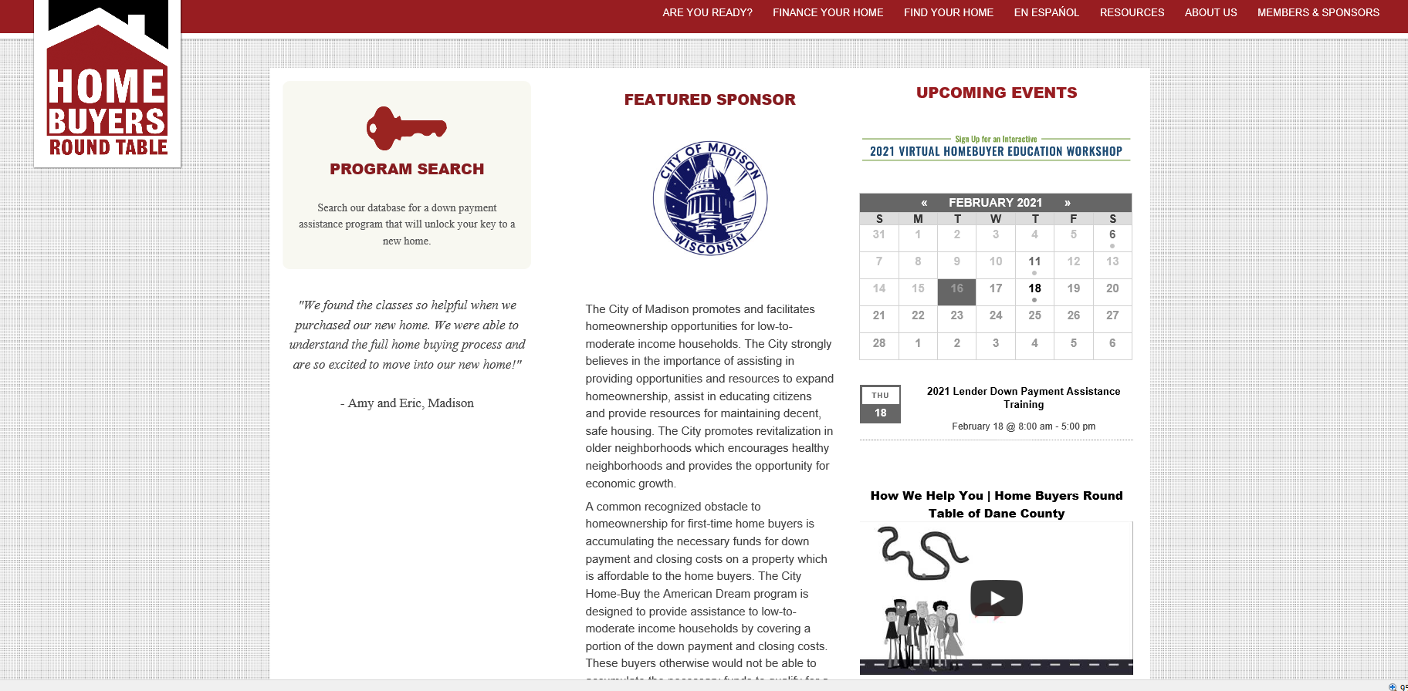
Home Buyers Round Table
www.homebuyersroundtable.org

Slide 4
Home Buyers Round Table

Slide 5
Income Limits
Change annually
Different for each county
Includes income of all adults in household (18+)
Generally 80% or less of county median income (CMI)
Varies by household size

Slide 6
Income Limits
2020 Income Guidelines by Household Size Dane County, WI
1 person | $54,950
2 person | $62,800
3 person | $70,650
4 person | $78,500
5 person | $84,800
6 person | $91,100
7 person | $97,350
8 person | $103,650

Slide 7
Other Eligibility Requirements
Home buyer education completion certificate
Single family homes/condo, ½ duplex
Owner-occupied
Some DPA are area-specific
Generally can’t have owned home in past 3 years
Most programs require some $ from borrower
*Some programs require borrower to be a US Citizen or Permanent Resident Alien

Slide 8
DPA Loan Programs

Slide 9
Home-Buy the American Dream
City of Madison $1,000 min.; $20,000 max
Dane County $1,000 min.; $5,000 max
Income limits 80% CMI
No interest, no monthly payment
Inspection(s) required

Slide 10
DownPayment Plus (DPP)
Amount varies; in 2021 up to $6,000
Matches 3 times borrower contribution (minimum of $1,000)
Statewide program
Income limit 80% CMI for specific county.
Lender must be member of FHLBC
5 year forgivable (1/60th per month)

Slide 11
Home Start
RASCW Housing Foundation
Lower of $4,000 or 3% of price
Income limit 80% CMI
Several counties – see matrix
2% interest per year - no payments required

Slide 12
Easy Close Advantage
Available statewide w/WHEDA 1st mortgage only
Greater of 3% or 3.5% or $3,000 - $3,500, depending on loan
Higher income limits than other DPA
Monthly payment required
Interest rate set by WHEDA

Slide 13
MOmentum
Dane County excluding City of Madison
Dane Co. funds adm. by Movin’ Out
≤$12,000
Income limit 80% CMI
No interest, no monthly payment
Inspection(s) required
No renters

Slide 14
Process
Lender and Realtor should be knowledgeable about DPA programs and requirements
Lender submits documents to DPA provider AFTER accepted offer
Allow time to meet specific program requirements (inspections).

Slide 15
Stacking Example
A family of 4 is purchase a property in the City of Madison with a purchase price of $225,000 and household income of $60,000. The household could be eligible for the following assistance if funds are available, and all criteria are met:
Down Payment Assistance Source | Maximum Amount of Assistance Based on Purchase Price of $225,000
City of Madison Home Buy American Dream | $20,000
Down Payment Plus | $6,000
Home Start | $4,000
Total Assistance | $30,000

Slide 16
Other Programs

Slide 17
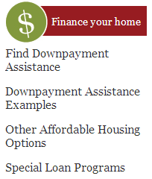
Home Buyers Round Table
Operation Fresh Start
Common Wealth Development
Habitat for Humanity
Wis. Partnership for Housing Development
Madison Area Community Land Trust
Urban League

Slide 18
Movin’ Out
Serves households ≤80% CMI that have a member with permanent disability
Contact Movin’ Out directly with questions
www.movin-out.org

