Slide 1


NEW MEMBER ORIENTATION
rascw.org 608-240-2800

Slide 2

INTRODUCTIONS
  Your Name
  Your Brokerage
  Why have you chosen real estate?
  What are you most excited about & least excited about?
  Hobbies/Family/Charity?

Slide 3

BEFORE WE GET STARTED
  Today is interactive. Please engage with the speakers and each other, and ask lots of questions!
  Please silence your phone and do not use it, or a laptop, during the presentation. Your full attendance, attention, and participation are required, and ringing phones and other distractions are not fair to other attendees.
  You will receive a link to this presentation following the session.

Slide 4


WHAT WE'LL COVER
Use of “REALTOR®”
You & Your Associations
Advocacy
Professionalism: Antitrust, Personal Safety, and Cybersecurity
Professional Standards: Ethics & Arbitration
Fair Housing
RASCW President & Your Swearing In
Optional Paragon Basics Training @3:00

Slide 5



PROPER USE OF “REALTOR®”

Slide 6



PROPER USE
OF “REALTOR®”
The REALTOR® Trademarks include:
  REALTOR®
  REALTORS®
  REALTOR-ASSOCIATE®
  The REALTOR® block “R” logo

Slide 7
The following are all proper uses of REALTOR® by a member named Jane Smith:
Proper Uses:
Janesmithrealtor
Jsmithrealtor
Smithrealtor
jane_smith_realtor
realtorjanesmith
realtorjsmith
jane_the_realtor
jane_a_realtor
PROPER USE
OF “REALTOR®”
The following are all improper uses of REALTOR® because they include a descriptive word or phrase in connection with the MARK:
Improper Uses:
Chicagorealtor
Yourchicagorealtor
your_chicago_realtor
cyberrealtor
virtualrealtor
realtor_mom
realtorsolution
localrealtor

Slide 8

KNOW THE RULES
  Needing to correct your website, domains, business cards, logo, etc. can get expensive!
  For additional resources, check out the Trademark Use Resource Guide located here:
https://www.nar.realtor/membership-marks-manual

Slide 9
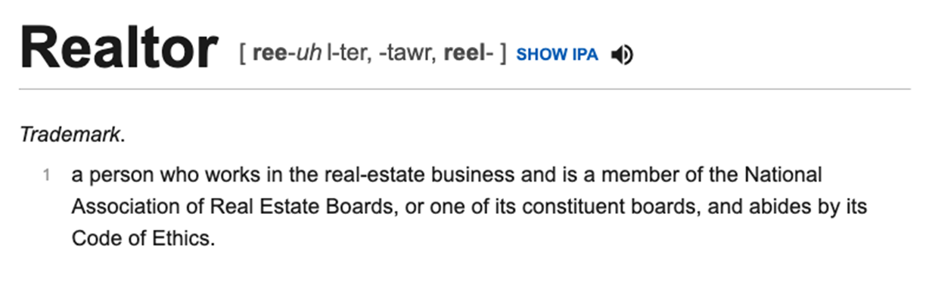
PRONUNCIATION
You Would Never Say “Doc-uh-tor” for Doctor, So Don'’t Say “Reel-uh-tor”!

Slide 10
YOU & YOUR ASSOCIATIONS
NAR: National Association of REALTORS®
WRA: Wisconsin REALTORS® Association
RASCW: REALTORS® Association of South Central WI

Slide 11


The Voice for Real Estate
NAR Consists of Members of ALL of the
STATE and LOCAL Associations NATIONWIDE.

Slide 12


BENEFITS & SERVICES
  Consumer Advertising Campaign
  Center for Financial Wellness
  Commitment to Excellence (C2EX)
  Library
  REALTOR® Magazine
  Market Statistics
  National Convention
  National REALTOR® Database
  RPR

Slide 13
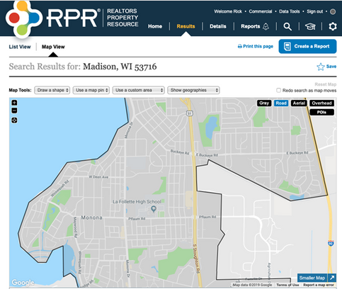
REALTORS® PROPERTY RESOURCE
www.NARRPR.com
100% OWNED BY REALTORS®:
Created by NAR for the sole purpose of providing data needed
to meet the demands of clients.
EXCLUSIVELY FOR REALTORS®:
No third party or public access. The only way a non-REALTOR® has access to the data is through a report CREATED by a REALTOR®
NO COST MEMBER BENEFIT:
RPR is a benefit offered exclusively to REALTORS® at NO COST. Services Residential, Commercial, Brokers, Appraisers and MLS's.

Slide 14

NAR.REALTOR/thats-who-we-r
Resources & Assets that you can use to promote your business.
THAT’S WHO WE R CAMPAIGN

Slide 15



Advanced Education & Designations
Accredited Buyer Representative
Certified Residential Specialist
Graduate, REALTOR® Institute

Slide 16

FINDING NAR RESOURCES
www.NAR.REALTOR
Online shopping for real estate products, including marketing strategies, statistics and much more, PLUS National REALTOR® Database and updates on real estate related issues.

Slide 17

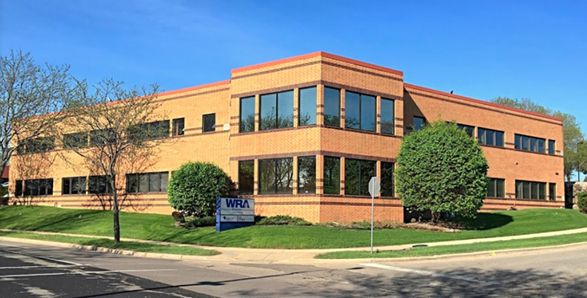
The WRA is a STATE ASSOCIATION
made up of Members of the NINETEEN Wisconsin Local Associations.

Slide 18

BENEFITS & SERVICES
  Continuing Education and Licensing Courses
  Success tips on building your business
  Access to ZipForms
  Legal updates on issues affecting the industry
  Legal Hotline
  Intervention with Department of Safety and Professional Services
  Government Affairs and Lobbying at State Level
  Wisconsin market statistics
  Monthly Magazine
  State Conventions

Slide 19
FINDING WRA RESOURCES
www.WRA.org
Online shopping for real estate products, including marketing strategies, statistics, and much more, PLUS Wisconsin REALTOR Database, Legal Hotline, and Updates on LOCAL real estate related issues.

Slide 20


Your LOCAL association.
RASCW is a TEAM made up of members (YOU), and the RASCW and South Central WI MLS staff!
Let’s get acquainted…

Slide 21
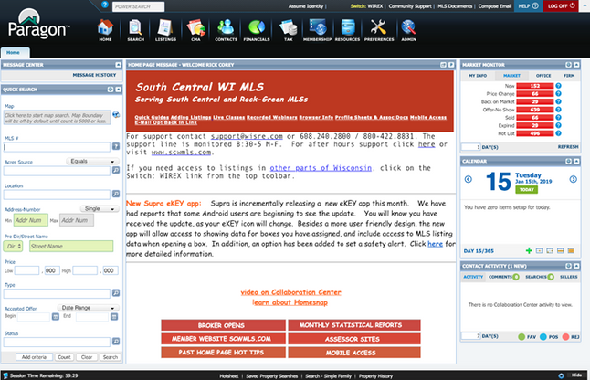
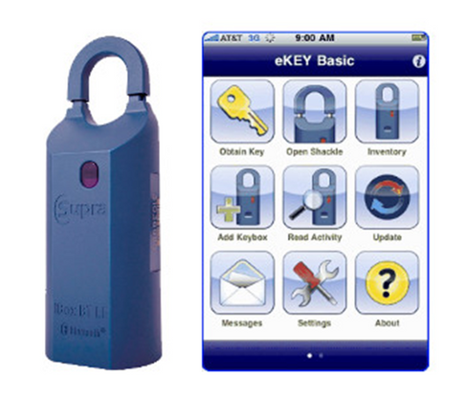
SOUTH CENTRAL WI MLS
www.scwmls.com
Listing Rules - Statistics - Support - Public Records - Forms
Statistics are pulled on the 12th of every month and published across social media platforms, as well as in the monthly newsletter.
Paragon MLS System: scwmls.paragonrels.com
Supra Keyboxes/eKEY

Slide 22

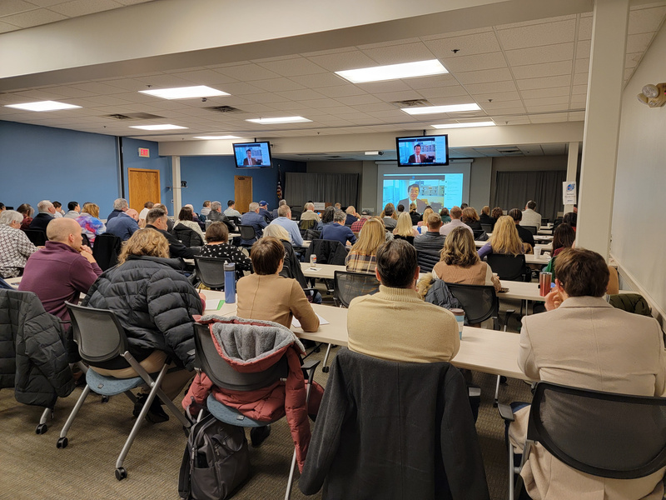
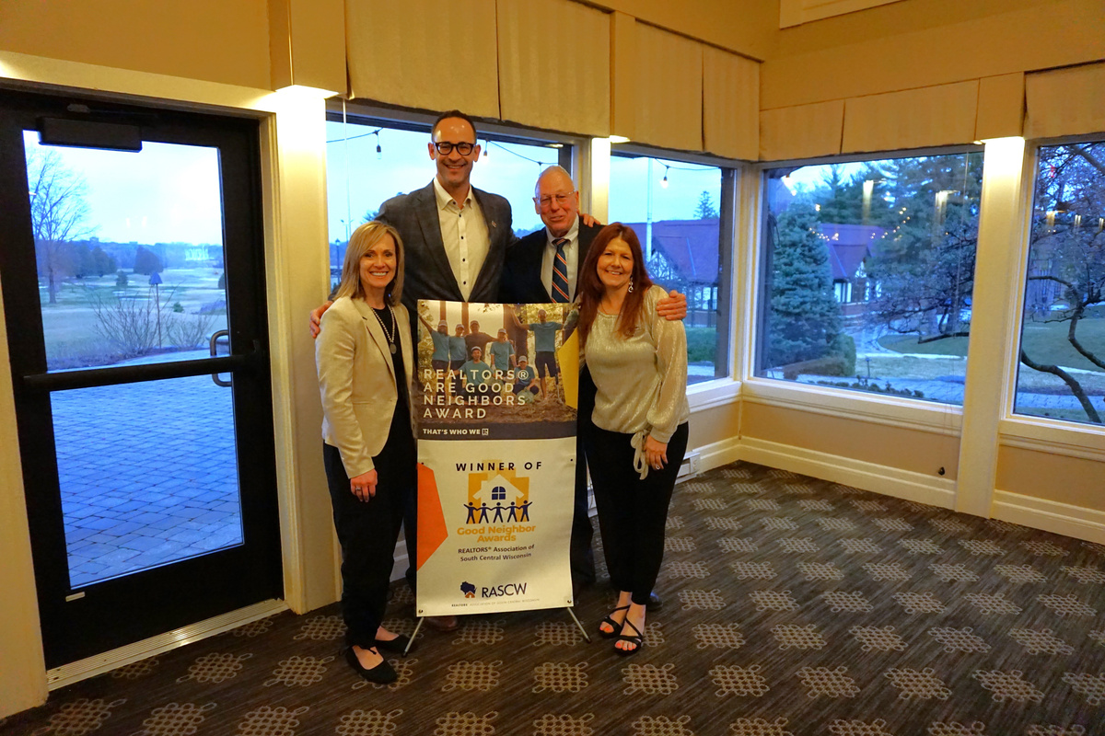
CONNECT
  Build Connections: Networking, outreach, committees
  Access Support: Staff, sponsorships, advertising
  Advocate: Industry and legislative action
RASCW MEMBER
BENEFITS & SERVICES
LEARN
  Empower Your Growth: Professional development and leadership.
  Stay Informed: Local market insights and industry updates
  Equip Your Success: Tools, resources, and ethics support
THRIVE
  Grow & Advance: Build your business and career
  Strengthen Communities: Support local growth & promote homeownership
  Sustain Industry Health: Back a strong real estate market
https://www.rascw.org/member-services/rediscover-the-value-of-rascw/

Slide 23
TASKFORCES/COMMITTEES:
TASKFORCES, COMMITTEES,& CHAPTERS
  Commercial Services
  Professional Standards
  Orientation
  Member/YPN Networking
  Learning Lab
  Community Engagement/Housing Awareness
  Investment Taskforce
  RASCW Housing Foundation
  Government Affairs
  MLS Committee
CHAPTERS:
  Green Lake Chapter
  Sauk Columbia Chapter
  Southwest Chapter

Slide 24
RASCW
EVENTS
Many events support causes in the community!
Memorial Golf Outing
Bocce Ball & Backpacks Tournament
Trivia Extravaganza
Bags Tournament
Euchre Tournament
Holiday Party & Gift Drive
Governmental Affairs Silent and Live Auction
https://members.rascw.org/events

Slide 25
COMMERCIAL REAL ESTATE
  RASCW Commercial Committee
  Commercial Events - this year:
    Introduction to Commercial Real Estate - national speaker
    Commercial Tools: REALTORS® Property Resource (RPR) webinar
    Annual Commercial Real Estate Summit
  Commercial Tools & Resources:
    Advocacy: nar.realtor/commercial/advocacy
    Research & Statistics: nar.realtor/research-and-statistics/research-reports/commercial-research
    Education: nar.realtor/commercial/courses-designations-and-events

Slide 26

Contact
rascw@wisre.com
HOW TO GET INVOLVED WITH RASCW:
www.rascw.org 608-240-2800
Look for emails from us and our monthly newsletter!
Facebook
Instagram
LinkedIn
Twitter
YouTube
HOW TO FIND
RASCW
RESOURCES:

Slide 27


ADVOCACY
The REALTOR® Party is a powerful alliance of REALTORS® and REALTOR® Associations working to protect and promote homeownership and property investment.

Slide 28
ADOCACY & CAMPAIGNS
The REALTOR® Party speaks with one voice to advance candidates and public policies on federal, state, and local levels that build strong communities and promote a vibrant business environment.
Locally, we support people and policies that promote homeownership, strong neighborhoods, and great schools.
The REALTOR® Party is forging a new path with a bipartisan, issue-oriented approach to politics. We support those who listen to and support us.

Slide 29
MEMBER MOBILIZATION
Calls For Actions (CFAs)
When the federal or state government is considering legislation that
affects the real estate industry, the NAR and WRA calls on its members to act.
Simply through contacting your local representative by responding to a CFA email or text, you can ensure that your business remains strong.
Sign up for Mobile Alerts by texting “REALTOR” to 30644

Slide 30
RASCW represents REALTORS® in Adams, Columbia, Crawford, Dane, Dodge, Grant, Green Lake, Iowa, Juneau, Lafayette, Marquette, Richland, Sauk, and Vernon counties. There are 61 units of government in Dane County alone.
We need your help! If you hear of something that is going on in your community that concerns you – call us. If it is of concern to you, it is a concern to our Association.

Slide 31
REALTOR® PROFESSIONALISM
  Antitrust: An Important Review
  Personal Safety
  Cyber Security

Slide 32
ANTITRUST REVIEW

Slide 33
REALTOR® PERSONAL SAFETY
Be Successful...but BE CAREFUL!
“That will never happen to me. Those sorts of things don't happen around here.”
- Almost Everyone
That quote could not be more wrong!

Slide 34
The US Bureau of Labor Statistics reported there were 87 fatal injuries in 2019 in relation to Real Estate, Rental, & Leasing.
14% of REALTORS® experienced a situation that made them fear for their personal safety or the safety of their information in 2020.
4% of REALTORS® were the victim of a crime related to their business in 2021.
Accidents and violence do NOT discriminate. Young, old, male, female….carelessness is a choice. BE SMART - BE ALERT - BE SAFE
REALTOR® PERSONAL SAFETY

Slide 35

REALTOR® PERSONAL SAFETY

Slide 36
START WITH A PLAN
Safety is a matter of common sense and thinking ahead:
  know your office safety procedures/policy
  if your office doesn't have a safety policy,
start the discussion
  RASCW/NAR can provide resources

Slide 37
Best Practice for
New Clients
  have first meeting (especially with new buyers) on neutral ground or in a public place
  get I.D. and share with office
  consider checking background

Slide 38

Tips for When You Do Meet a Stranger On Site
  don't get parked in
  don't be the first one down stairs or
into rooms
  make sure someone knows where you are
  drive separately or have a buddy with you
  find the exits
  beware of showings that are rushed, last minute, late, during bad weather, remote, or at a vacant property or poorly lit location

Slide 39
FREE MEMBER SAFETY APP:
  In 2021, RASCW partnered with SafeShowings to provide members free access to their mobile app designed to keep REALTORS® safe.
  Click here for details and to download the app
  Click here for more RASCW safety resources
  RASCW offers a free annual safety program, usually in September. Watch the website and social media for information.
REALTOR® PERSONAL SAFETY

Slide 40
REALTOR® PERSONAL SAFETY
NAR REALTOR® SAFETY PROGRAM PROVIDES:
  Help with planning safety strategy
  Tips and best practices
  Safety training videos
  Among those who participated in a REALTOR® safety course, 39 percent said they feel more prepared for unknown situations after taking the course.
https://www.nar.realtor/safety

Slide 41

REALTOR® CYBER SECURITY
What is the projected annual global cost of cybercrime
by 2025?
An Estimated $10.5 Trillion!
Most of that will not come from large corporations, but from small businesses with 25 employees or less. It is
the “small fish” that are largely unprotected.
https://www.nar.realtor/law-and-ethics/cybersecurity-checklist-best-practices-for-real-estate-professionals

Slide 42
TIME FOR A BREAK!
PLEASE BE BACK IN 5 MINUTES

Slide 43

The National Association of Realtors® requires Local Associations to provide at least 2 ½ hours of Professional Standards training to all new Realtors®.
CODE OF ETHICS
The Code is the core philosophy that guides how we do business.
OUR GOAL TODAY:
To get you familiarized with how the Code of Ethics works in our day-to-day business
PROFESSIONAL STANDARDS:
ETHICS & ARBITRATION

Slide 44

CODE OF ETHICS
HISTORY & BACKGROUND
  In 1908, the National Association of Real Estate Exchanges (now National Association of Realtors®) was founded by real estate practitioners determined to unite the real estate profession with the goal of establishing high ethical standards to protect buyers and sellers.
  In 1913, the National Code of Ethics was the first created and has been revised over time.

Slide 45



  PREAMBLE
  Sets the tone
  Importance of real estate to society
  Duties of real estate professionals
CODE
OF ETHICS
2. ARTICLES
  The rules grouped into three categories:
3. STANDARDS OF PRACTICE
  Provisions that expound upon and clarify the rules
  Interpret, amplify, and give examples of how rules are applied

Slide 46

Protect and promote client's interest while treating all parties honestly
  1-3: Don't mislead about value to get a listing. “I can get you $10k more than the other guy.”
  1-6: Submit all offers timely and objectively. “That buyer is being unreasonable.”
  1-15: Disclose existence of offers if seller approves. This covers offers before acceptance.
CODE OF ETHICS:
ARTICLE 1

Slide 47
CODE OF ETHICS:
ARTICLE 2
Don't exaggerate, misrepresent, or conceal pertinent facts. “We've never had any flooding in the basement.”
You don't have to discover latent defects. What do you do once you are aware of them?
Don't disclose facts which are confidential. e.g. marital status, financial info, other deals...

Slide 48
Cooperate with other brokers as long as it helps your client.
  3-1: Listing broker sets the terms of offers to cooperate
  3-4: Disclose variable rate commission
  3-6: Disclose existence of accepted offers
  3-8: Don't lie about availability of a property for showings
CODE OF ETHICS:
ARTICLE 3

Slide 49
CODE OF ETHICS:
ARTICLE 4
If sale or purchase is for you or immediate family member, disclose in writing before signing of any contract
  Put it in broker-to-broker remarks
  Put it in the offer
“Agent drafting this offer is the father of the buyer…”

Slide 50
CODE OF ETHICS:
ARTICLE 5
Disclose your present or contemplated interest in a property before providing professional service
  Get another agent to help out with the market analysis if you think you might want to buy it…

Slide 51
CODE OF ETHICS:
ARTICLE 6
  Disclose any fee or financial benefit you may receive from recommending related real estate products or services.
  Get client's informed consent before accepting any compensation.

Slide 52
CODE OF ETHICS:
ARTICLE 7
Realtors® receive compensation from one party only, unless they make full disclosure and receive informed consent from their client.
  Listing Agreement and Buyer Agency Agreement both have language available to handle this.

Slide 53
CODE OF ETHICS:
ARTICLE 8
Realtors® holding client or customer funds should keep them in a separate escrow account.

Slide 54
CODE OF ETHICS:
ARTICLE 9
All agreements related to real estate transactions should be in writing and a copy given to each party upon signing.
  Use written extensions or amendments
  Disclose and explain terms prior to getting electronic signatures

Slide 55

Do not discriminate in providing services or real estate employment for reasons of:
race, color, religion, sex, handicap, familial status, national origin, sexual orientation or gender identity.
  10-5: REALTORS® must not use harassing speech, hate speech, epithets, or slurs based on race, color, religion, sex, handicap, familial status, national origin, sexual orientation, or gender identity. (Adopted and Effective 11/2020)
CODE OF ETHICS:
ARTICLE 10

Slide 56
CODE OF ETHICS:
ARTICLE 11
Practice competently.
  Live up to the standards of practice and competency reasonably expected in your discipline.
  Don't practice outside your expertise unless you get help or without full disclosure to client.

Slide 57
Present a true picture on your advertising and other public representations.
  12-7: Can only say you “sold” the property if you participated as listing or cooperating broker.
  12-8: True picture applies to the internet as well, so keep your website current and accurate.
  12-10: Don't use misleading URL, domain names, meta tags, keywords or framing of other sites to mislead or manipulate others’ content.
CODE OF ETHICS:
ARTICLE 12

Slide 58
CODE OF ETHICS:
ARTICLE 13
If you're not a lawyer, don't act like one…
  Don't give legal advice
  Encourage use of an attorney where appropriate

Slide 59
Cooperate with the Association of Realtors®
  Participate willingly in ethics and arbitration enforcement actions
  Whether charged with unethical practice, asked to present evidence, or asked to appear before professional standards
CODE OF ETHICS:
ARTICLE 14

Slide 60

Don't lie about other Realtors®
  We have it hard enough without Realtors® slinging mud at each other
  Don't mislead others about your competitors
  Don't make a bad or insincere ethics complaint
  Don't repeat someone else's lies (e.g. Blogs)
CODE OF ETHICS:
ARTICLE 15

Slide 61
Don't interfere with other agents' clients.
  16-4 and 5: Don't solicit a listing that is currently listed, nor a buyer currently in a buyer agency agreement.
  16-6: You can talk to that client if they initiate the discussion with you.
  16-9: Before they sign an agreement with you, ask if they are currently in an agreement for the same service.
CODE OF ETHICS:
ARTICLE 16

Slide 62
CODE OF ETHICS:
ARTICLE 17
REALTORS® agree to arbitrate their money disputes arising in real estate transactions.
Arbitration discussion coming up next!

Slide 63
ETHICS COMPLAINTS
  Arises from an alleged violation of the NAR Code of Ethics
  Can be filed by a member of the public or a fellow REALTOR®
  It's NOT about money, it's about behavior

Slide 64
ETHICS COMPLAINTS: DISCIPLINE OPTIONS
  Letter of Warning
  Letter of Reprimand
  Education
  Fine not to exceed $15,000
  Suspension for not less than 30 days nor more than one year
  Expulsion from membership for one to three years
  Suspension or termination of MLS Privileges
  Administrative processing fee of $350

Slide 65
LUNCH BREAK
WE'LL START AGAIN AT 1:00

Slide 66
ARBITRATION
Article 17 – Code of Ethics​
We REALTORS® agree to arbitrate
our commission disputes.​

Slide 67
ARBITRATION
  Arbitration is about money disputes​
  Having this process available is a benefit of being a REALTOR®​
  It is a fair, thorough, and accessible process​
  Of course, it's always best to avoid or resolve disputes – tips coming!

Slide 68
Listing Contract​
Seller pays ​
listing broker
Buyer Agency​ -
3 options:​
  Buyer pays buyer broker​
  Offer of Compensation​
  Commission put into the offer – seller pays to buyer broker​
WHERE THE MONEY COMES FROM
Subagency​
Listing agent pays
subagent's broker​ the
Offer of ​Compensation​

Slide 69
How Could This Happen to Me?​
  Example 1​:
    You have a new listing. A buyer calls you for a showing and you take them through the property. Two days later they have a buyer agent take them through and they write an offer.​

Slide 70
How Could This Happen to Me?​
  Example 2:​
    You are hosting an open house for another agent in your firm. A buyer comes through, spends a lot of time with you, asks you a lot of questions, and emails you the next day with more questions, which you answer. They ask you to let them walk through the house another time, which you do. Then a day later they have a buyer agent write an offer for them.​

Slide 71
How Could This Happen to Me?​
  Example 3:​
    An agent takes a buyer on a showing of a property, then writes an offer for that buyer on the property. The offer is not accepted. The listing expires and is listed by a new brokerage. The buyer goes to a new agent who writes a new offer on the property which is accepted.​

Slide 72
WHAT TO DO NEXT
  Talk to your manager/broker​
  Maybe resolve the dispute or head off a dispute​
  Maybe prepare just in case it can't be resolved​
  Generally disputes are REALTOR®​ to REALTOR®​, but they can also be Public pulling a REALTOR®​ into our own process. (Public to REALTOR®​ is all contract-based)​

Slide 73
QUESTIONS TO ASK
  Is There An Offer of Compensation?
    Check with the listing broker, listing broker website, etc.
    Consider written compensation agreement or some means of proving this offer​

Slide 74
QUESTIONS TO ASK
2. What Was the Offer of Compensation?
    Listing broker can unilaterally change before submission of offer
    If needed, verify before submission

Slide 75
QUESTIONS TO ASK
3. Who is Entitled to the Offer of Compensation?
    Standard of Performance
    It is up to the listing broker
    May be something specific to getting offer accepted and closing
    May be Procuring Cause (will discuss next)

Slide 76
PROCURING CAUSE
DEFINITION:
The uninterrupted series of events that results in the sale of the property to the buyer.​

Slide 77
  No one action establishes it​
    Showing the property first​
    Wrote the offer first​
  No one action precludes it​
    No agency disclosures given​
    Did not show the property​
PROCURING CAUSE

Slide 78
Interruption of Series of Events​
  Abandonment​
    Buyer feels like the agent is no longer engaged or responsive​
  Estrangement​
    Buyer feels like the agent has done something to alienate the buyer or to lose the buyer's trust or confidence​
PROCURING CAUSE

Slide 79
Timeline to Consider
  Introduction of buyer to the property up to buyer’s decision to offer
  Other prior showings are not relevant​
  Hard work to bring the accepted offer to close not relevant​
PROCURING CAUSE

Slide 80
Transaction Timeline
-Agent #1 meets the buyer
-Agent #1 and buyer discuss agency relationships and buyer received an agency
disclosure form
-Agent #1 and buyer discuss the type of property buyer is looking for
-Agent #1 shows buyer information about 57 houses meeting buyer’s general criteria
-AGENT #1 INTRODUCES BUYER TO THE HOUSE
-Buyer sees 16 houses
-Buyer sees the house
-Buyer sees 8 other houses
-Buyer gets information about neighborhood
-Buyer sees the house again with agent #2
-Buyer and seller negotiate
-Agent #1 drafts buyer’s offer to purchase on the house
-SELLER ACCEPTS THE OFFER
-The transaction moves forward and contingencies are satisfied or fulfilled
-Before closing, agent #2 and their firm claim to be procuring cause
-Transaction closes. Listing firm refuses to pay commission because of the
procuring cause claim
PROCURING CAUSE

Slide 81
Special Note About
Buyer Agency​
Having a buyer agency with a buyer does not guarantee that you have met the standard of performance for entitlement to the listing broker’s offer of compensation.​
PROCURING CAUSE

Slide 82
  Talk to your buyers​
  Listen to your buyers​
  Arrange for back-up​
  Communicate with other agent, particularly if you're the BA​
  Get things in writing​
  Take good notes​
  Consult with your manager/broker​
  Negotiate a compromise, if necessary​
AVOIDING COMMISSION DISPUTES

Slide 83
Filing Arbitration – Key Requirements​
  Unresolved Commission Dispute​
  Closed Real Estate Transaction​
  Must File within 180 days of closing (or after the facts could have been known)​

Slide 84
ARBITRATION PROCESS
  Grievance Panel​
The Grievance Panel will decide if the complaint is proper to move
forward, or if not, it can be amended or dismissed.​
​
2. Mediation​
Mandatory mediation with association-provided mediator who is
approved by parties. Opportunity to craft your own resolution and
not roll the dice with a hearing.​
3. Hearing Panel​
You make your case before 3 or 5 member panel chosen from
Professional Standards Committee. Parties may object to panel
members if they feel the panel member cannot be impartial.​

Slide 85
  Fair, Thorough​
  Straight-Forward Procedure​
  Sworn Testimony​
  Witnesses Allowed​
  Attorney Allowed (not required)​
  Easy to Submit Evidence​
  Hearing is Run According to NAR Guidelines​
THE HEARING

Slide 86
THE HEARING
What Will the Panel Consider?
  Full consideration of all the relevant facts​
  Any action/inaction, showings, discussions, information shared, continuity of contact, offer written, and any other actions or events that establish that the agent met the standard of performance​

Slide 87
THE DECISION
  Complainant has the burden of proof: Preponderance of Evidence​
  Hearing Panel decides who is entitled to the disputed money​
  Parties may request procedural review based on lack of due process​
  If no procedural review or review shows there was due process, the panel's decision becomes final​

Slide 88
FAIR HOUSING
It is YOUR responsibility to know and follow all Fair Housing Laws in the areas you serve.
State and Federal Law prohibits discrimination in housing on the basis of a person's membership in a protected class. In Wisconsin, those are:
  Race
  Color
  Family Status
  Disability
  Sex
  National Origin
  Religion
  Marital Status
  Ancestry
  Source of Income
  Sexual Orientation
  Age
  Status as a victim of Domestic Abuse, Sexual Assault, or Stalking

Slide 89
FAIR HOUSING
3:00-4:47

Slide 90
FAIR HOUSING
DESCRIBE THE PROPERTY, NOT THE PEOPLE
  Printing or publishing any statement or advertisement that indicates a preference, limitation, or discrimination based on a protected class
  Always describe the features of the property and avoid describing the ‘prospects’ you may think would be potential buyers/renters

Slide 91
DISABILITY: #1 FAIR HOUSING COMPLAINT IN WISCONSIN
  Federal Fair Housing Act protects the right of people with disabilities to keep support or companion animals, even when a condo rule or policy explicitly prohibits larger pets by weight.
  It is unlawful for a landlord to refuse to allow a reasonable modification to the premises when such modification may be necessary to afford persons with disabilities full enjoyment of the premises. i.e. widening doorways, adding a ramp, lowering counter heights, installing grab bars, etc.
FAIR HOUSING

Slide 92
FAIR HOUSING

Slide 93

MISSION: The Home Buyer’s Round Table of Dane County is a collaboration of housing industry representatives that promote homeownership through education and counseling to low and moderate income families. We believe homeownership will increase family stability and financial security, stabilize and strengthen communities and neighborhoods, generate jobs and stimulate economic growth.
Visit us at homebuyersroundtable.org

Slide 94
THE REALTOR® PLEDGE
with
RASCW President

Slide 95
PLEASE STAND:
  “Do you affirm your full acceptance of the duties and responsibilities of membership and agree to uphold the bylaws and the ethical standards of the Realtors® Association of South Central Wisconsin?”
  If so, please signify by saying “I Do”
  Now I ask that you all recite the REALTOR® pledge together.
  Please raise your right hand and repeat after me:
THE
REALTOR® PLEDGE

Slide 96
  I pledge myself to strive to be honorable and to abide by the Golden Rule;
  To strive to serve well my community, and through it, my country;
  To abide by the REALTORS'® Code of Ethics and to strive to conform my conduct to its aspirational ideals;
  To act honestly in all real estate dealings;
  To protect the individual right of real estate ownership and to widen the opportunity to enjoy it;
  To seek to better represent my clients by building my knowledge and competence.
THE
REALTOR® PLEDGE

Slide 97
CONGRATULATIONS &
WELCOME TO RASCW!!!
Presentation of certificates and pins
A link to the presentation slides will be emailed
rascw.org 608-240-2800

